Slide 1
~ 8.2 FLOOD ~
Pei Sun Loh
Ocean College, Zhejiang University 23rd June 2026

Slide 2
CONTENTS
Bangladesh
Impacts of climate change and human activities
Impacts of flood on hydrological cycle, carbon cycle

Slide 3
IMPACTS OF CLIMATE CHANGE AND HUMAN ACTIVITIES

Slide 4
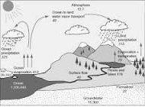
In Central and Eastern Europe, mean temperature （T） is projected to increase between 1 and 3ºC in the next decade, and up to 5ºC until the end of the century
Higher T leads to intensification of water cycle
Climate warming will lead to increase evaporation
Moisture holding capacity of increased
Generally leads to changes in rainfall pattern

Slide 5
Key changes to hydrological cycle due to increased greenhouse gasses
Seasonal distribution and amount of precipitation
Precipitation vary with seasons across different regions
More intense precipitation, but reduced frequency of precipitation and more dry periods
Increase evapotranspiration and decrease soil moisture
Increase evapotranspiration – increase droughts
Changes balance between snow and rain
Increase precipitation as rain than snow
Earlier snowmelt
Stagl et al. (2013)

Slide 6
Climate change and flood/drought
There is a direct influence of global warming on changes in precipitation and heavy rains
Increased heating – increased evaporation
Water holding capacity of air increases by 7% per 1ºC warming – increased water vapour – affect precipitation
Extreme weather events – heavy rainfall and flood
Surface drying – increased intensity and duration of drought
Affect agriculture, hydrology and water resources
Trenberth (2005)

Slide 7
Human activities and flood
Catastrophic floods in Viet Nam have been increasingly linked to land use and forest cover change
Catastrophic flood in downstream due to changes in rainfall
Overall increasing trends of catastrophic flooding in Huong river basin due to:
Climate variability
Road development
Dyke infrastructure
Tran et al. (2010)

Slide 8
Impacts of flood on carbon & nutrient cycle
71% & 85% of the total OC was exported in flow events occurring during less than 20% of that time
Highlight the importance of short-duration, high-discharge events (common in smaller watershed) in controlling annual OC export
Increase in annual discharge – increased 40% of DOC export past 50 years
Increased agriculturally derived OC
Dalzell et al. (2007)

Slide 9

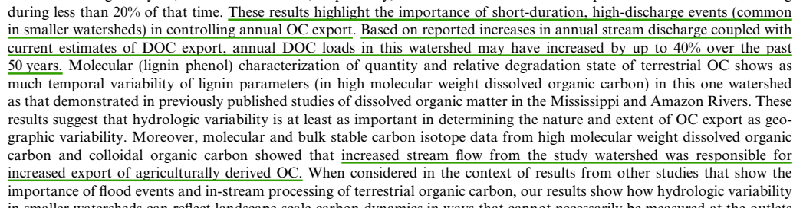

Slide 10
Po River, Italy, experienced a 100-year flood in October 2000
Surface sediments were collected from Po prodelta in December 2000, October 2001 and April 2002
Sedimentary organic matter was dominated by aged, lignin-poor, fine materials
2 years after the flood, post-depositional process has increased lignin and coarse material (silt and sand), and reduced aged OC
Tesi et al. (2008)

Slide 11
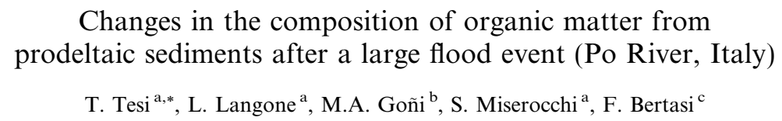
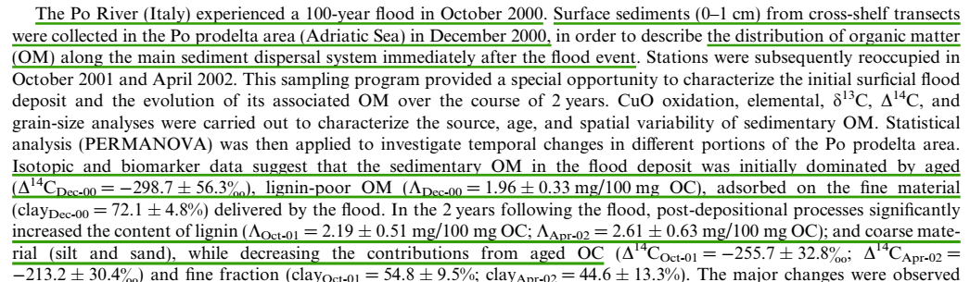

Slide 12
The Elbe flood generated a large influx of nutrients and dissolved and particulate OC on the coast
These conditions subsequently lead to onset of phytoplankton bloom and DO supersaturation
2 months after the flood, water column stratification and high phytoplankton production and prolonged Do supersaturation in surface waters throughout SE German Bight
Prolonged stratification led to widespread bottom water dissolved oxygen depletion
Voynova et al. (2017)

Slide 13
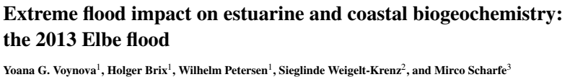
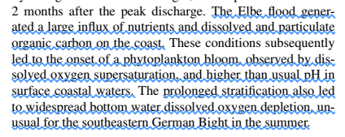

Slide 14
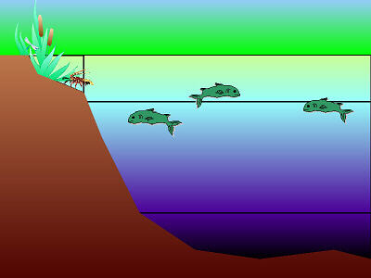

1
2
2
106 CO₂ + 122 H₂O + 16 HNO₃ + H₃PO₄ (CH₂O)₁₀₆(NH₃)16H₃PO₄ + 138 O₂
3
4
(CH₂O)₁₀₆(NH₃)16H₃PO₄ + 138 O₂ 106 CO₂ + 122 H₂O + 16 HNO₃ + H₃PO₄
4

Slide 15
SUMMARY

Slide 16
Flood has caused | Water layer | Processes | CO₂ | Nutrients | O₂ | Is CO2 released to the atm?
nutrients | Surface water |  |  |  |  | No/Yes (C sink/course)
 | Sub-surface water
DOC | -
fresh terrestrial OM | -
aged OM | - | X | X | X | X
photosynthesis
106 CO₂ + 122 H₂O + 16 HNO₃ + H₃PO₄ (CH₂O)₁₀₆(NH₃)16H₃PO₄ + 138 O₂
respiration
(CH₂O)₁₀₆(NH₃)16H₃PO₄ + 138 O₂ 106 CO₂ + 122 H₂O + 16 HNO₃ + H₃PO₄

Slide 17
References
Banerjee L. 2007. Effect of flood on agricultural wages in Bangladesh: and empirical analysis. World Development 35 (11), 1989-2009.
Choudhury et al. 2014. Impact of coastal embankment on the flash flood in Bangladesh: a case study. Applied Geography 24, 241-258.
Dalzell et al. 2007. The role of hydrology in annual organic carbon loads and terrestrial organic matter export from a midwestern agricultural watershed. Geochimica et Cosmochimica Acta 71, 1448-1462.
Gebremichael et al. 2017. Flood-related increases in CO₂ and N₂O emissions from a temperate coastal grassland ecosystem. Biogeosciences 14, 2611-2626.

Slide 18
Islam N. 2001. The open approach to flood control: the way to the future in Bangladesh. Futures 33, 783-802.
Kanii et al. 2002. The impact on health and risk factors of the diarrhoea epidemics in the 1998 Bangladesh floods. Public Health 116, 68-74.
Karim MF and Mimura N. 2008. Impacts of climate change and sea-level rise on cyclonic storm surge floods in Bangladesh. Global Environmental Change 18, 490-500.
Stagl et al. 2013. Chapter 3. Effects of climate change on the hydrological cycle in central and eastern Europe. In“Managing protected areas in central and eastern Europe under climate change”(Rannow A and Neubert M, editors). Advances in Global Climate Research 58, 31-44pp.

Slide 19
Tesi et al. 2008. Changes in the composition of organic matter from prodeltaic sediments after a large flood event (Po River, Italy). Geochimica et Cosmochimica Acta 72, 2100-2114.
Tran et al. 2008. Catastrophic flood and forest cover change in the Huong river basin, central Viet Nam: a gap between common perceptions and facts. Journal of Environmental Management 91, 2186-2200.
Trenberth KE. 2005.The impact of climate change and variability on heavy precipitation, floods, and droughts. Encyclopedia of Hydrological Sciences (Anderson MG, ed.) 11 pp.
Voynova et al. 2017. Extreme flood impact on estuarine and coastal biogeochemistry: the 2013 Elbe flood. Biogeosciences 14, 541-557.

Slide 20
THANK YOU

